Slide 1
A SIMPLE AND CONVINIENT APPROACH FOR A PROBLEM STATEMENT
BY VAIRAVEL AND AAKASH

Slide 2
Problem Statement
1. Statement - Kitchen Description Builder. 40 marks
Description: Build algorithms to automate text generation for the kitchen type based
on the menus that kitchen offers. The summary should be 2-3 lines in the mobile screen width.
For instance:
• This home chef specializes purely Punjabi dishes specifically country / village style dishes. Generally, these dishes are made with organic ingredients.
• This kitchen brings the best out of Keralite food, very authentic and delicious
specials.
• Prema is passionate about making delicacies of Italian food and enjoys cooking
unique culinary specials of Italy.

Slide 3
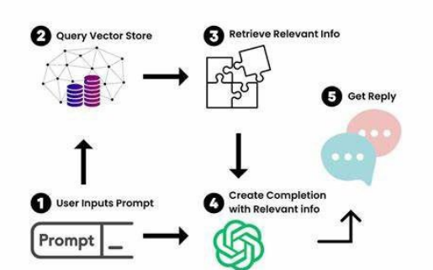
WORK FLOW

Slide 4
MAIN OBJECTIVES
To reduce the manual effort for describe the each and every food item that belong to the respective kitchen will be displayed on the COOKR APP
By using the AI Model ,we can solve this problem very efficiently
By Analyse dataset, the description of the food item will display automatically based on the kitchen with the help of AI

Slide 5
ALGORITHM
@ STEP 1 : To create a Dataset for different food items for different kitchen.
@ STEP 2 : To built a website by using STREAMLIT module
@ STEP 3 : By using GENERATIVE AI module, we can retrive respective output by analysing the dataset based on the given input.
@ STEP 4 : To link the generative AI MODULE with website by using streamlit library

Slide 6
CONCLUSION
THE DESCRIPTION OF THE KITCHEN WILL AUTOMATICALLY GENERATE BY USING DATASET WITH THE HELP OF AI.

